Slide 1
Defender for IoT - OT Networks
Azure Partner Security Deep-Dive

Slide 2

Agenda
Operational Technology (OT) Background & Overview
Purdue Model
Mitre ATT&CK Framework
Customer Challenges
Use Cases

Slide 3

Industry 4.0, Digitalization, Internet of Things (IoT)
The rise of Industry 4.0 has introduced a whole new range of security issues now that IT, operational technology (OT) and intellectual property have been integrated.
Trends towards automation and data exchange in manufacturing technologies and processes which include cyber-physical systems (CPS), the internet of things (IoT), industrial internet of things (IIOT), cloud computing, cognitive computing and artificial intelligence.
Autonomous Robots
1784
1870
1969
2011
Big Data
Simulation
1.0
2.0
3.0
4.0
Augmented Reality
System Integration
Industry 4.0
Mechanization
Water power
Stream power
Mass production
Assembly line
Electricity
Computer
Automation
Robotics
Cyber-physical systems
IoT
Cloud computing
Cognitive computing
Additive Manufacturing
Internet of Things
Cloud Computing
Cybersecurity

Slide 4
Longer lifetimes present new challenges
IMPORTANT! Many devices are in remote locations hundreds of kilometers away from support technicians
Must support old devices with little/zero security
Must ensure new devices are set up for the long term
Some devices do not support agents
IT Device Lifetime
IIoT/IoT could have long lifetime
Hardware lifecycle warranty for 30-50 years
Some machines are 50 years old (often with digital retrofit added in last 20-30 years)
OT DEVICE LIFETIME
OT DEVICE LIFETIME
OT DEVICE LIFETIME
1784
1870
1969
4.0
2011
Autonomous Robots
1.0
2.0
3.0
4.0
Big Data
Simulation
Augmented Reality
Industry 4.0
System Integration
Mechanization
Water power
Stream power
Mass production
Assembly line
Electricity
Computer
Automation
Robotics
Cyber-physical systems
IoT
Cloud computing
Cognitive computing
Additive Manufacturing
Internet of Things
Cloud Computing
Cybersecurity
Notes:
Is the trend towards automation and data exchange in manufacturing technologies and processes which include cyber-physical systems (CPS), the internet of things (IoT), industrial internet of things (IIOT), cloud computing, cognitive computing and artificial intelligence.
The rise of Industry 4.0 has introduced a whole new range of security issues now that IT, operational technology (OT) and intellectual property have been integrated.

Slide 5
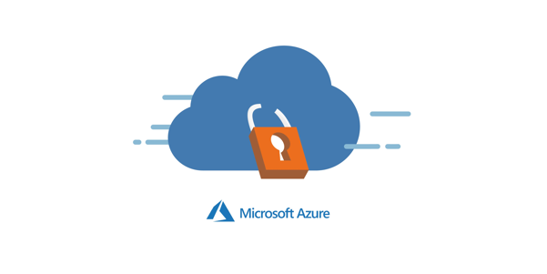
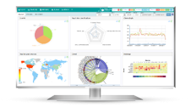
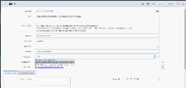
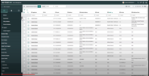


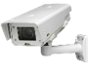
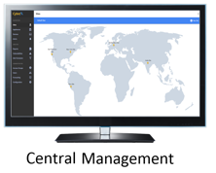
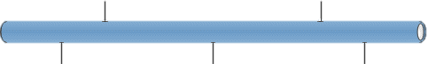



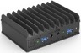







Plant Architecture
Data Center / Industry 4.0 / SOC / MSSP
ITSM
SIEM
Asset Management
Integration / Cloud
On-Premises
NGFW
Enterprise
Corporate Network
IT
SSL
SSL
SSL
Mgmt
Mgmt
Mgmt
OT
NGFW
Sensor
Sensor
Sensor
Port Mirroring
One-Way
Port Mirroring
One-Way
Port Mirroring
One-Way
Port Mirroring
Industrial DMZ
IDMZ
Air-Gapped
Industrial Zone 1
Air-Gapped
Industrial Zone 2
Air-Gapped
Industrial Zone 3
SCADA / DCS
Security Update
Server
Domain
Controller
Production Floor
NGFW
Notes:
CLICK IN SLIDE MODE TO START ANIMATION

Slide 6
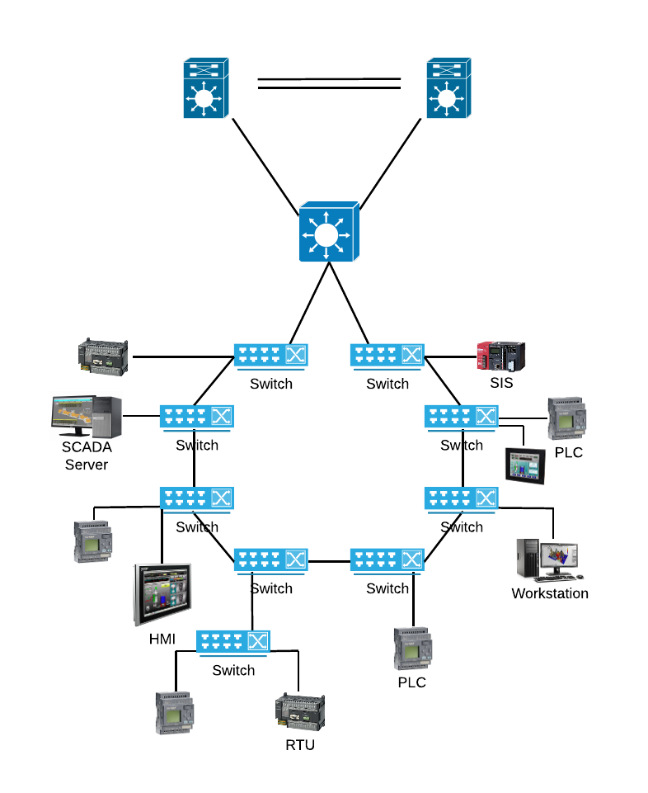
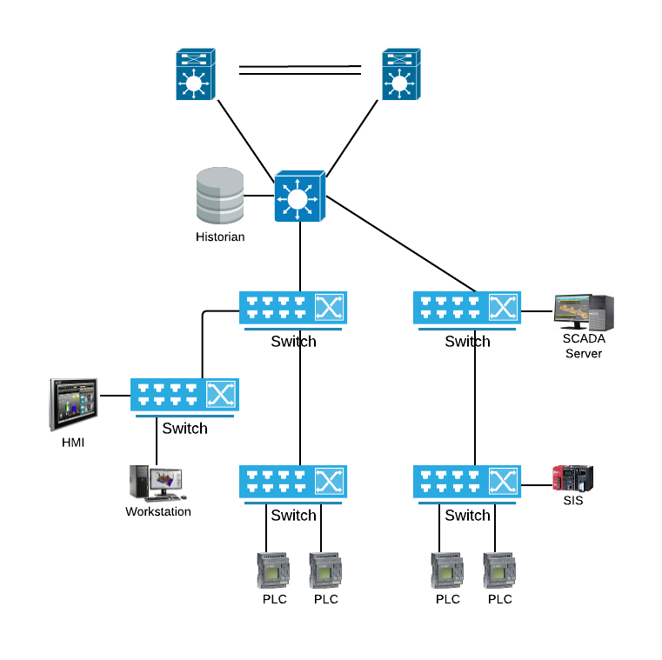
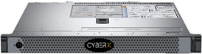
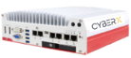
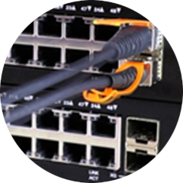
Common Network Topologies in OT environments
Ring
Tree / Star
IT
IT
OT
OT
Mirror
Traffic
Appliance
Mirror
Traffic
Mirror
Traffic
Mirror
Traffic
Appliance

Slide 7

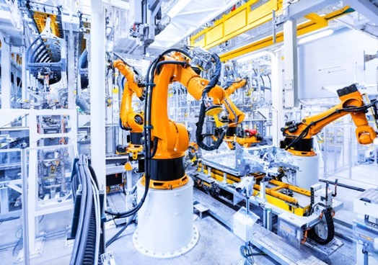



How Gartner defines Operational Technology (OT) security
“The practices and technologies used to protect people, assets and information involved in the monitoring and/or control of physical devices, processes and events.”
Manufacturing, energy & water utilities, smart buildings, chemicals, pharmaceuticals, oil & gas, transportation & logistics, mining, life sciences, retail, …
Notes:
https://www.gartner.com/reviews/market/operational-technology-security

Slide 8
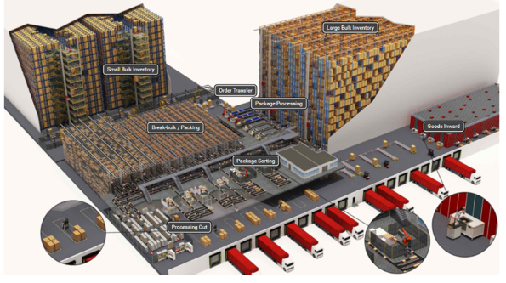
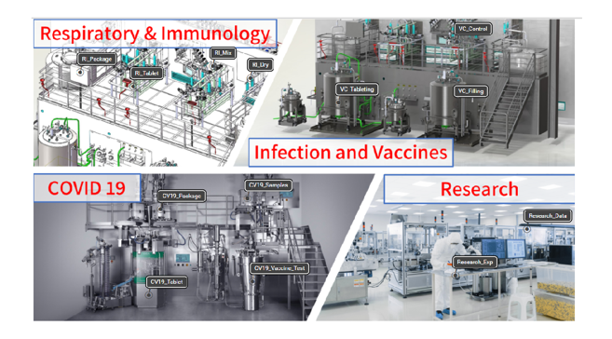
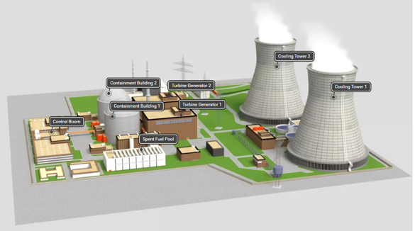
Some Examples of OT Environments
Smart Factories & Distribution Centers
Pharma
Power Generation
Hardware and software dedicated to detecting or causing changes in physical processes through direct monitoring and/or control of physical devices such as valves, pumps, etc.

Slide 9
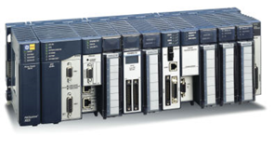
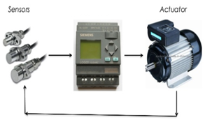
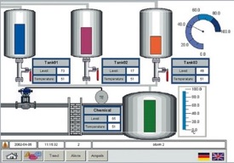
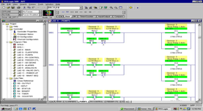

Industrial Control Systems (ICS) Components
PLC – Programmable Logic Controller
RTU – Remote Terminal Unit
HMI – Human Machine Interface
EWS – Engineering WorkStation
Historian
Notes:
Top five intelligent RTU market vendors
ABB
ABB provides power and automation technologies for utility, industry, and transport and infrastructure customers worldwide. As of December 2015, the company had 140,400 employees globally and generated total revenues of $35.48 billion.
ABB manufactures and markets a variety of products, including variable speed drives, wind converters, PLCs, motors, generators, robots and robotics, solar inverters, components, and subsystems for railways and related services for a broad range of applications, including process industries, discrete automation, transportation, and utilities.
GE Grid Solutions
GE Grid Solutions is a sub-segment of the energy management segment of General Electric (a diversified infrastructure and financial services corporation). Also, a joint venture of Alstom and GE. GE Grid Solutions provides solutions that modernize grid management and supply power to consumers. It develops, designs, manufactures, and installs a broad range of integrated hardware and software solutions for energy intensive industries, including oil and gas, petrochemicals, utilities, mining, water, heavy industrial, and telecommunications.
Honeywell
Honeywell is a diversified technology and manufacturing company worldwide. The company operates through two business segments: automation and control solutions, and others.
Schneider Electric
Schneider Electric produces a wide range of equipment and components for electricity distribution, energy management, and automation management. Used in a wide range of areas such as computer and peripheral, network and server, data center and facility 3 phase, UPS management, home UPS, UPS replacement batteries, and special applications (includes industrial, telecommunication, and marine). This segment’s key offerings include battery backup, surge protection, power protection, compatibility with three-phase UPS products, monitoring, and control functionality, battery management, and interface cables.
Siemens Energy
Siemens Energy was formerly known as Siemens Power Generation and changed its name to Siemens Energy in October 2008. It operates as a subsidiary of Siemens. The company manufactures fossil fuel power plants and power-generating components, smart meters, gas and steam turbines, wind turbines, generators, renewables, solar power plants, geothermal energy systems, hydro and wind power plants, environmental systems, photovoltaic inverters, fuel gasifier systems, and fuel cells.

Slide 10


Industrial Control Systems (ICS) Components
PLC – Programmable Logic Controller
PLC receives information from connected sensors or input devices, processes the data, and triggers outputs based on pre-programmed parameters.
ABB, Allen Bradley, Siemens, Mitsubishi, Honeywell, Motorola, Hitachi, General Electric, etc
RTU – Remote Terminal Unit
RTU and PLCs perform similar functions, but used in wider geographical telemetry
ABB, GE Grid Solutions, Honeywell, Schneider Electric, Siemens Energy
Reprogramming PLCs quickly allows companies to reset their assembly lines for different products
PLCs are good for manufacturing environments
Preprogrammed interfaces allows easy installation and long-term use of RTUs
RTUs are better suited for remote operations and harsh environmental conditions
 | PLCs | RTUs
How is it configured? | Programmed by plant engineer | Vendor pre-programmed
Power | Moderate to High power consumption | Low power consumption
Network Requirements | Wired – High speed | Wireless, Radio or Satellite - High or Low speed
Environment | Moderate durability | Ruggedized for harsh environments, temperature, etc
Example Application | PLC in manufacturing line for automobile, pharmaceuticals or smart warehouse | RTU on an off-shore oil rig
Notes:
Top five intelligent RTU market vendors
ABB
ABB provides power and automation technologies for utility, industry, and transport and infrastructure customers worldwide. As of December 2015, the company had 140,400 employees globally and generated total revenues of $35.48 billion.
ABB manufactures and markets a variety of products, including variable speed drives, wind converters, PLCs, motors, generators, robots and robotics, solar inverters, components, and subsystems for railways and related services for a broad range of applications, including process industries, discrete automation, transportation, and utilities.
GE Grid Solutions
GE Grid Solutions is a sub-segment of the energy management segment of General Electric (a diversified infrastructure and financial services corporation). Also, a joint venture of Alstom and GE. GE Grid Solutions provides solutions that modernize grid management and supply power to consumers. It develops, designs, manufactures, and installs a broad range of integrated hardware and software solutions for energy intensive industries, including oil and gas, petrochemicals, utilities, mining, water, heavy industrial, and telecommunications.
Honeywell
Honeywell is a diversified technology and manufacturing company worldwide. The company operates through two business segments: automation and control solutions, and others.
Schneider Electric
Schneider Electric produces a wide range of equipment and components for electricity distribution, energy management, and automation management. Used in a wide range of areas such as computer and peripheral, network and server, data center and facility 3 phase, UPS management, home UPS, UPS replacement batteries, and special applications (includes industrial, telecommunication, and marine). This segment’s key offerings include battery backup, surge protection, power protection, compatibility with three-phase UPS products, monitoring, and control functionality, battery management, and interface cables.
Siemens Energy
Siemens Energy was formerly known as Siemens Power Generation and changed its name to Siemens Energy in October 2008. It operates as a subsidiary of Siemens. The company manufactures fossil fuel power plants and power-generating components, smart meters, gas and steam turbines, wind turbines, generators, renewables, solar power plants, geothermal energy systems, hydro and wind power plants, environmental systems, photovoltaic inverters, fuel gasifier systems, and fuel cells.

Slide 11
Industrial Control Systems (ICS) Components
PLC – Programmable Logic Controller
PLC receives information from connected sensors or input devices, processes the data, and triggers outputs based on pre-programmed parameters.
ABB, Allen Bradley, Siemens, Mitsubishi, Honeywell, Motorola, Hitachi, General Electric, etc
RTU – Remote Terminal Unit
RTU and PLCs perform similar functions, but used in wider geographical telemetry
ABB, GE Grid Solutions, Honeywell, Schneider Electric, Siemens Energy
HMI – Human Machine Interface
HMI represents plant information to the operating personnel graphically in the form of diagrams
Mitsubishi Electric, Omron, Rockwell, Schneider Electric, etc
EWS – Engineering WorkStation
Very reliable computer designed for configuration, maintenance and diagnostics of the Industrial Control System (ICS) applications
Historian
Architected to pull data from a variety of systems to quickly form a complete context of the manufacturing environment.
Schneider Electric Wonderware, OSISoft PI, Rockwell
Notes:
Top five intelligent RTU market vendors
ABB
ABB provides power and automation technologies for utility, industry, and transport and infrastructure customers worldwide. As of December 2015, the company had 140,400 employees globally and generated total revenues of $35.48 billion.
ABB manufactures and markets a variety of products, including variable speed drives, wind converters, PLCs, motors, generators, robots and robotics, solar inverters, components, and subsystems for railways and related services for a broad range of applications, including process industries, discrete automation, transportation, and utilities.
GE Grid Solutions
GE Grid Solutions is a sub-segment of the energy management segment of General Electric (a diversified infrastructure and financial services corporation). Also, a joint venture of Alstom and GE. GE Grid Solutions provides solutions that modernize grid management and supply power to consumers. It develops, designs, manufactures, and installs a broad range of integrated hardware and software solutions for energy intensive industries, including oil and gas, petrochemicals, utilities, mining, water, heavy industrial, and telecommunications.
Honeywell
Honeywell is a diversified technology and manufacturing company worldwide. The company operates through two business segments: automation and control solutions, and others.
Schneider Electric
Schneider Electric produces a wide range of equipment and components for electricity distribution, energy management, and automation management. Used in a wide range of areas such as computer and peripheral, network and server, data center and facility 3 phase, UPS management, home UPS, UPS replacement batteries, and special applications (includes industrial, telecommunication, and marine). This segment’s key offerings include battery backup, surge protection, power protection, compatibility with three-phase UPS products, monitoring, and control functionality, battery management, and interface cables.
Siemens Energy
Siemens Energy was formerly known as Siemens Power Generation and changed its name to Siemens Energy in October 2008. It operates as a subsidiary of Siemens. The company manufactures fossil fuel power plants and power-generating components, smart meters, gas and steam turbines, wind turbines, generators, renewables, solar power plants, geothermal energy systems, hydro and wind power plants, environmental systems, photovoltaic inverters, fuel gasifier systems, and fuel cells.

Slide 12




IT and OT Networking Background
Purdue Model
Enterprise Network (IT)
LEVEL 4 & 5
Enterprise
IT
Computer Servers
Internet
LEVEL 3 / 3.5
Industrial DMZ
Router
PSTN Trunks/ PRI Lines
Wireless Controller
UTM/ Firewall
LEVEL 2
Supervisory
NAS – Network Area Storage
IP Telephony Server
Core Switch
LEVEL 1
OT
Process Control
Distribution Switches
Edge Switches
LEVEL 0
Field Control
Wireless Access Points
IP Surveillance Cameras
Soft Phones
MFP/ Network Printers
IP Video Conf
PC
IP Phones
Scanner
Operational Technology (OT) Network
Industrial Internet Of Things (IIOT)
Industrial Control Systems (ICS) or SCADA

Slide 13
Aligning IT and OT
Purdue Model
ENTERPRISE NETWORK (IT)
LEVEL 4 & 5
Enterprise
IT
Organizational Alignment between IT and OT is critical for Operational success
Different groups need to work together in order to provide successful integration and visibility
Understanding political boundaries are key to success integration
LEVEL 3 / 3.5
Industrial DMZ
LEVEL 2
Supervisory
LEVEL 1
OT
Process Control
LEVEL 0
Field Control
Operational Technology (OT) Network
Industrial Internet Of Things (IIOT)
Industrial Control Systems (ICS) or SCADA

Slide 14
Aligning IT and OT
Purdue Model
ENTERPRISE NETWORK (IT)
Organizational Alignment between IT and OT is critical for Operational success
Different groups need to work together in order to provide successful integration and visibility
Understanding political boundaries are key to success integration
LEVEL 4 & 5
Enterprise
IT
LEVEL 3 / 3.5
Industrial DMZ
LEVEL 2
Supervisory
CIO/COO
LEVEL 1
OT
Process Control
CISO
VP Operations Line of Business
LEVEL 0
Field Control
Director Info Security
General Manager
Security Mgr/Analyst
Plant Engineer
Operational Technology (OT) Network
Industrial Internet Of Things (IIOT)
Industrial Control Systems (ICS) or SCADA

Slide 15

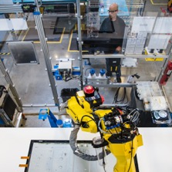
Supervisory Control And Data Acquisition (SCADA)
Ability to Control
Ability to Monitor and Collect Information
ICS
Industrial Control Systems
DCS
Distributed Control Systems
PCN
Process Control Network
IT Security
OT Security
Data confidentiality & privacy
High levels of connectivity
Standard protocols & devices
Multiple layers of controls & telemetry
Safety & availability
Traditionally air-gapped
Specialized protocols, devices & legacy OS platforms
Little or no visibility into IoT/OT risk

Slide 16
Supervisory Control And Data Acquisition (SCADA)
Ability to Control
Ability to Monitor and Collect Information
ICS
Industrial Control Systems
DCS
Distributed Control Systems
PCN
Process Control Network
I’m glad we are one happy secure IT, OT, ICS company now.
Can you please use the correct term, so I know what you are talking about?
IT Security
OT Security
Data confidentiality & privacy
High levels of connectivity
Standard protocols & devices
Multiple layers of controls & telemetry
Safety & availability
Traditionally air-gapped
Specialized protocols, devices & legacy OS platforms
Little or no visibility into IoT/OT risk
Director Info Security
Plant Engineer
Security Mgr/Analyst

Slide 17
IT Security ≠ OT Security
 | IT | OT
Communication Protocols | Standard IT protocols | Proprietary, Customized
O/S | Standard Windows | Old Windows, Linux/Unix, Embedded platforms (PLC, DCS)
Network Behavior | Non-deterministic behavior (humans) | Deterministic behavior (M2M)
Risk Assessment | Active vulnerability scanning | Passive threat hunting
Security Patching | Regular patching using direct internet connection or WSUS | No patching or OS upgrades. If exist, very complicated process
Security Focus | Confidentiality -> Data integrity -> Availability | Safety & Operational process! Availability -> Data integrity -> Confidentiality

Slide 18
Timeline of Growing Threats to IoT/OT Infrastructure
LockerGoga ransomware strikes 5 firms including Norsk Hydro causing $70M+ losses
Industroyer attack on Ukrainian grid: 1st autonomous targeted IIoT malware
NotPetya (Russia) & WannaCry (DPRK) cause billions of dollars of damage for industrial firms
DHS confirms Russian threat actors are in US critical infrastructure
Black Energy attack on Ukrainian electrical grid disables 50 substations — destroys hard drives, battery backups, & access to controllers
World learns of TRITON attack on petrochemical facility: disables safety controllers
Microsoft finds IoT campaign using VoIP & printers as entry points to corporate networks
Stuxnet destroys centrifuges in air-gapped Iranian nuclear facilities
Mirai IoT DDoS attack takes down internet
Iran targets Fortinet, PAN, Citrix routers
Cozy Bear VPNfilter malware exploits 500,000 routers & NAS devices
Malware exploits building access control systems
2009
2015
2016
2017
2018
2019
EternalBlue exploit stolen from NSA

Slide 19
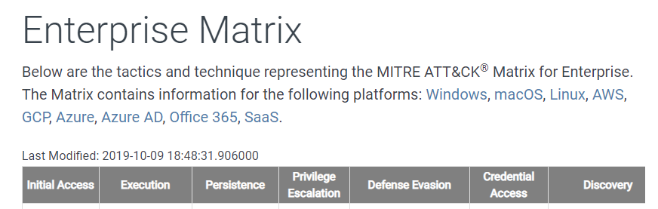

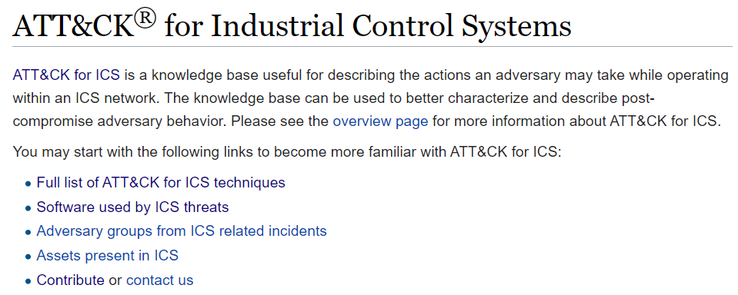
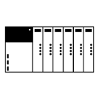




Mitre ATT&CK Framework
Internet
https://attack.mitre.org/matrices/enterprise/
LEVEL 4 & 5
Enterprise
Remote Access
Desktops
Printers
Network Phones
IT
LEVEL 3 / 3.5
Industrial DMZ
Remote Access
Historian
Domain Controller
https://collaborate.mitre.org/attackics/index.php/Main_Page
LEVEL 2
Supervisory
Historian
Engineering Station
HMI
LEVEL 1
OT
Process Control
PLC
RTU
LEVEL 0
Field Control
Sensor
Actuator
Sensor
Actuator

Slide 20
Mitre ATT&CK Framework Background
Internet
https://attack.mitre.org/matrices/enterprise/
LEVEL 4 & 5
Enterprise
Remote Access
Desktops
Printers
Network Phones
IT
LEVEL 3 / 3.5
Industrial DMZ
Remote Access
Historian
Domain Controller
https://collaborate.mitre.org/attackics/index.php/Main_Page
LEVEL 2
Supervisory
Historian
Engineering Station
HMI
LEVEL 1
OT
Process Control
PLC
RTU
LEVEL 0
Purdue is a connectivity model and common language, security must be layered on top of it
Field Control
Sensor
Actuator
Sensor
Actuator

Slide 21
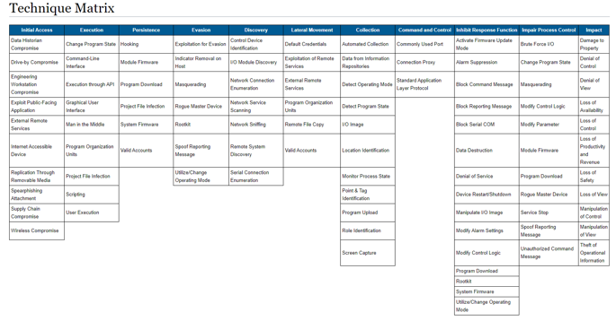
Mitre ATT&CK FOR ICS
11 Tactics
Initial Access
Discovery
Collection
Lateral Movement
Evasion
Command and Control
Execution
Persistence
Impact
Impair Process Control
Inhibit Response Function
ICS specific information to classify Tactics, Techniques and Procedures (TTPs)
11 Tactics
Common Language
Implied timeline of how close an adversary is to objective
81 Techniques
Specific methods that adversaries use to compromise ICS Components
Software used by ICS threats
Specific malware (Conficker, LockerGoga, Triton, NotPetya, etc)
Adversary groups from ICS related incidents
mapped to publicly reported technique use
mapped to reported software used during intrusions
Assets present in ICS

Slide 22
Timeline vs Mitre Tactics
11 Tactics
Initial Access
Discovery
Collection
Lateral Movement
Evasion
Command and Control
Execution
Persistence
Impact
Impair Process Control
Inhibit Response Function
Initial Access
Discovery
Collection
Lateral Movement
Evasion
Command & Control
Impact
Impair Process Control
Inhibit Response
Execution
Persistence
Timeline

Slide 23
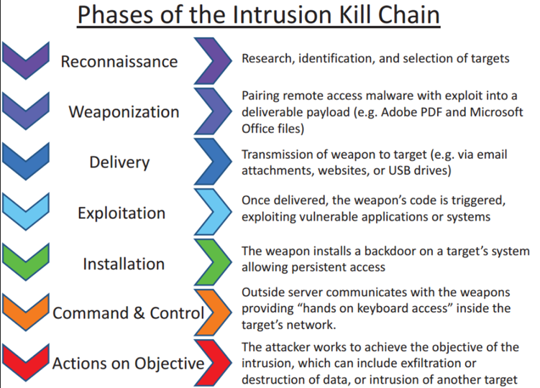
Kill Chain vs Mitre Tactics
https://en.wikipedia.org/wiki/Kill_chain
Reconnaissance
Command & Control
Weaponization
Installation
Delivery
Exploitation
Initial Access
Discovery
Collection
Lateral Movement
Evasion
Command & Control
Impact
Impair Process Control
Inhibit Response
Execution
Persistence
Actions on Objectives
Timeline

Slide 24
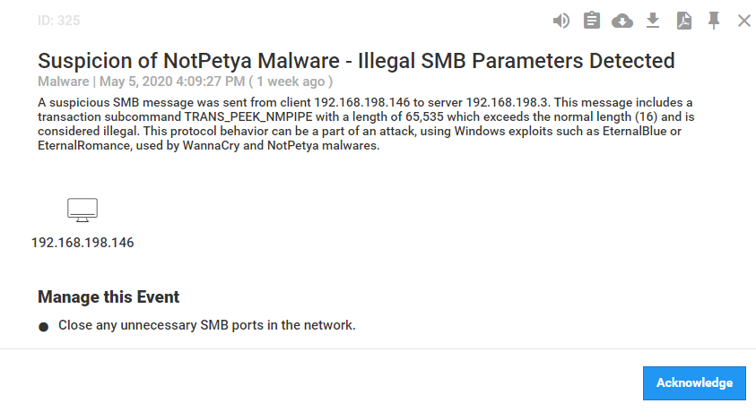
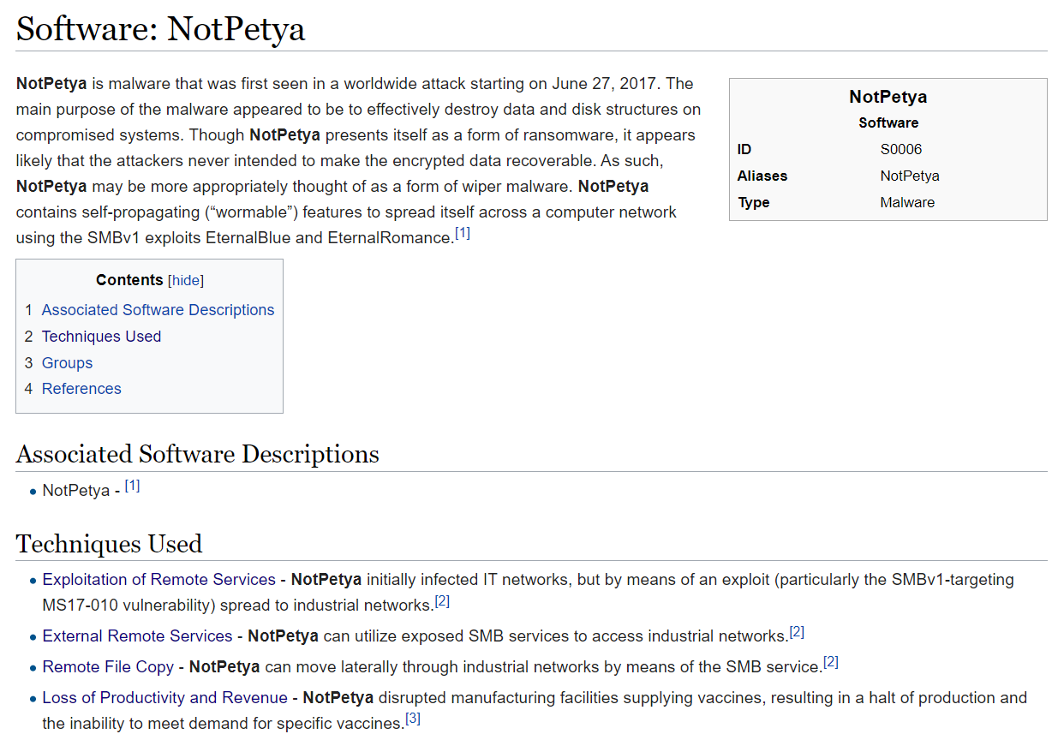
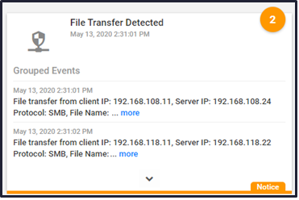
Mitre Tactics and Techniques
Tactic: Initial Access,
Lateral Movement
Tactic: Lateral Movement
Tactic: Lateral Movement
Top 6 firms impacted by NotPetya lost $129M- $870M
Tactic: Impact

Slide 25
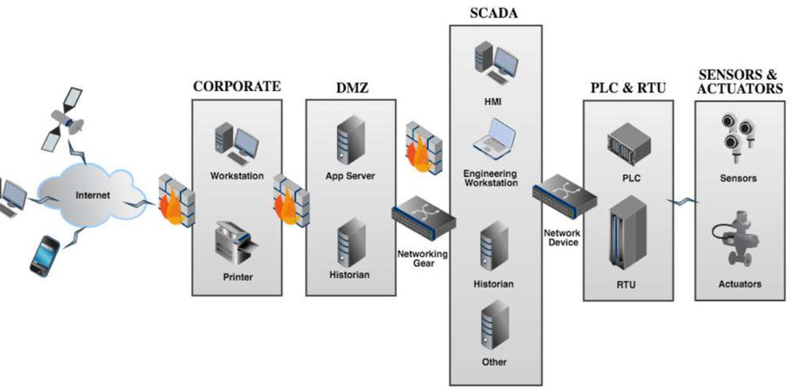



TRITON Kill Chain Example
Windows Defender Advanced Threat Protection & Defender for IoT simultaneously detect suspicious RDP access from IT to OT network — alerts converged in Azure Sentinel incident
Deploy PC malware
1
2
3
4
Steal credentials
Install RAT in safety PLC
Disable safety PLC & launch 2nd cyberattack
TriStation Protocol
L4
L3
L1
L0
L2
Notes:
https://www.darkreading.com/attacks-breaches/triton-trisis-attack-was-more-widespread-than-publicly-known/d/d-id/1333661

Slide 26

TRITON Cyberattack on Petrochemical Facility
Deploy PC malware
1
2
3
4
Steal OT credentials
Install RAT in safety PLC
Disable safety PLC & launch 2nd cyberattack
TriStation Protocol
Initial Access
Discovery
Collection
Lateral Movement
Evasion
Command & Control
Impact
Impair Process Control
Inhibit Response
L4
L3
Execution
Persistence
L1
L0
T870 - Detect Program State
T820 - Exploitation for Evasion
T857 - System Firmware
T857 - System Firmware
T868 - Detect Operating Mode
T853 - Scripting
T855 - Unauthorized Command Message
T808 - Control Device Identification
T872 - Indicator Removal on Host
L2
T871 - Execution through API
T880 Loss of Safety
T818 - Engineering Workstation Compromise
T885 - Commonly Used Port
T843 - Program Download
T833 - Modify Control Logic
T846 - Remote System Discovery
T858 - Utilize/Change Operating Mode
T875 - Change Program State
T858 - Utilize/Change Operating Mode
T849 - Masquerading
T849 - Masquerading

Slide 27
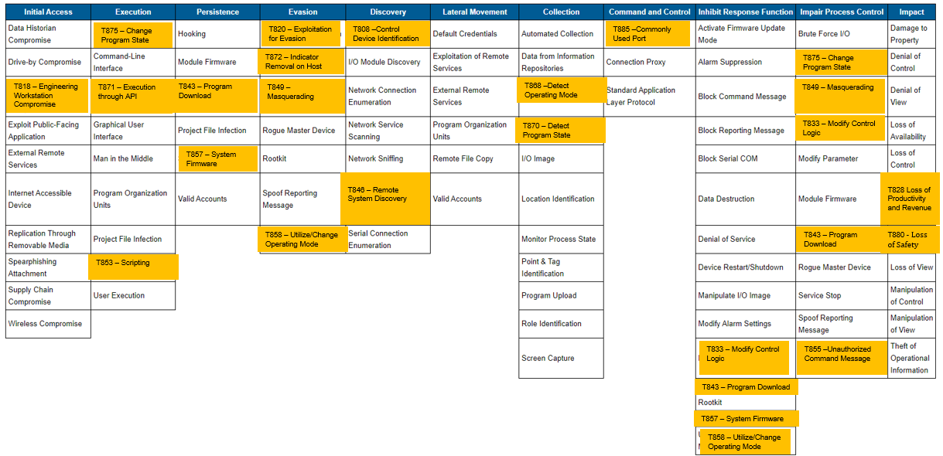
Triton Mitre ATT&CK Mapping
Technical Details
https://cyberx-labs.com/blog/triton-post-mortem-analysis-latest-ot-attack-framework/

Slide 28
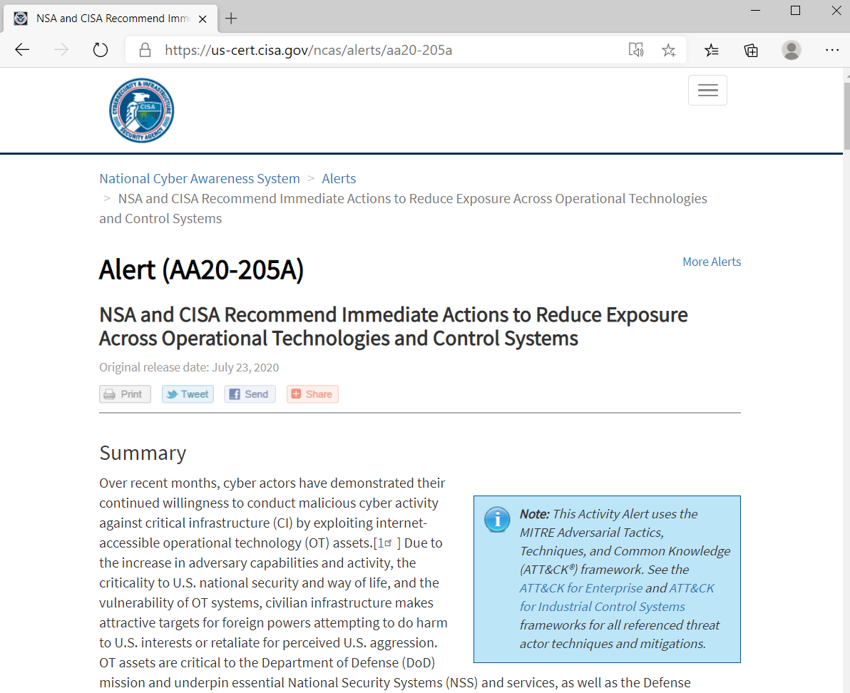
US Cybersecurity and Infrastructure Security Agency (CISA)/NSA Advisory (July 23, 2020)
“Cyber actors have demonstrated their continued willingness to conduct malicious cyber activity against critical infrastructure.”
Internet-accessible OT assets are becoming more prevalent
Legacy OT assets that were not designed to defend against malicious cyber activities
Create an Accurate “As-operated” OT Network Map Immediately
Use the validated inventory to investigate which OT devices are internet-accessible
Catalog all external connections to and from the OT networks.
Implement a continuous and vigilant system monitoring program with anomaly detection.

Slide 29
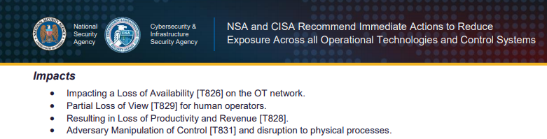
Recently Observed Tactics, Techniques, and Procedures(TTPs)
Spear phishing [T1192] to obtain initial access to the organization’s information technology (IT) network before pivoting to the OT network.
Deployment of commodity ransomware to Encrypt Data for Impact [T1486] on both networks.
Connecting to Internet Accessible PLCs [T883] requiring no authentication for initial access.
Utilizing Commonly Used Ports [T885] and Standard Application Layer Protocols [T869], to communicate with controllers and download modified control logic.
Use of vendor engineering software and Program Downloads [T843].
Modifying Control Logic [T833] and Parameters [T836] on PLCs.

Slide 30
IoT/OT cyber risk = business risk
Production downtime
Loss of sensitive intellectual property
Safety & environmental incidents
Financial losses
Top 6 firms impacted by NotPetya lost $129- $870M
Norsk Hydro lost $71M due to LockerGoga attack
Reduced competitive posture
Manufacturing firms are 8x more likely to be breached for theft of trade secrets than other verticals
(2020 DBIR)
Compliance violations, legal liability & brand impact
USCG reports port cargo handling equipment compromised via Ryuk
TRITON attack on safety controllers of petrochemical facility
Notes:
https://www.wired.com/story/notpetya-cyberattack-ukraine-russia-code-crashed-the-world/
https://www.cyberscoop.com/cyber-insurance-norsk-hydro-lockergoga-attack/
https://www.zdnet.com/article/us-coast-guard-discloses-ryuk-ransomware-infection-at-maritime-facility/

Slide 31
What Gartner is Saying About Cyber-Physical Systems (CPS) Liability
“The FBI, NSA and Cybersecurity and Infrastructure Security Agency (CISA) have already increased the frequency and details provided around threats to critical infrastructure-related systems, most of which are owned by private industry. Soon, CEOs won’t be able to plead ignorance or retreat behind insurance policies.”
Katell Thielemann, research vice president, Gartner
75% of CEOs will be personally liable for CPS incidents by 2024.
The financial impact of CPS attacks resulting in fatal casualties will reach over $50 billion by 2023.
A focus on ORM – or operational resilience management - beyond information-centric cybersecurity is sorely needed.
https://www.gartner.com/en/newsroom/press-releases/2020-09-01-gartner-predicts-75--of-ceos-will-be-personally-liabl

Slide 32
Why did Microsoft acquire CyberX?
Address security concerns to enable cloud workloads
Complete a gap in the IoT/IIoT device coverage
Best in class product for IoT security
Proprietary protocol knowledge
Section 52 Research Team (OT/ICS)
Enhance Sentinel (SIEM & SOAR) with more IoT device coverage
IoT Devices
Cloud Connected IoT Devices
Industrial IoT Devices
On-Prem IoT Devices
Source: Bain, “Beyond Proofs of Concept: Scaling the Industrial IoT”, January 2019
Percentage of Industrial IoT customers citing each adoption barrier as a top concern
Notes:
IoT investments for managing and securing the production environment
Industrial and On Prem are a large segement of this domain

Slide 33
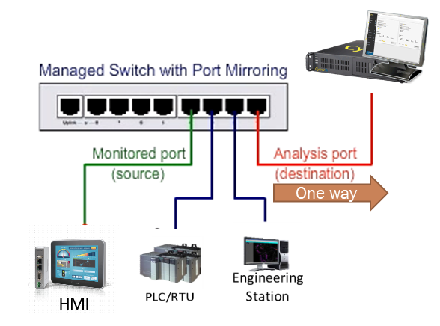
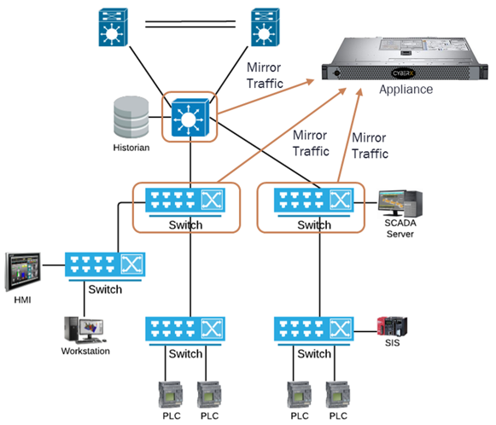
Defender for IoT (CyberX) Sensor
Physical appliance or virtual machine
Fully passive – non-intrusive
Listens on a switch mirror port/network tap
Ability to connect to multiple switches
“Smart Sensor”
Stand-alone or part of multilayer architecture

Slide 34

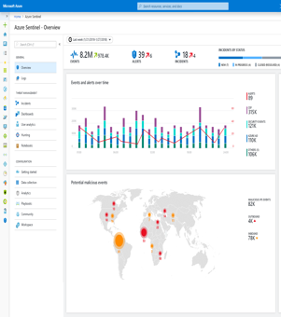
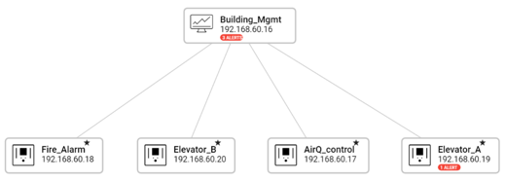
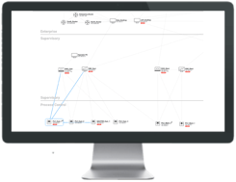




Simple, non-invasive deployment — network-layer monitoring
Sensor performs Deep Packet Inspection (DPI) using patented, IoT-aware behavioral analytics
SIEM/SOAR
Azure Security Center and/or local web console
Assets
Vulnerabilities
Threats
Alerts
Virtual or physical appliance
Application
TCP Application
IP TCP Application
Network
Packet Capture
Ethernet IP TCP Application
SPAN port
OT Network
OT Network
Notes:
CLICK IN SLIDE MODE TO START ANIMATION

Slide 35




Defender for IoT: Agentless Security for Unmanaged Devices
Purpose-built OT security platform for Industrial IoT networks
Deep knowledge of specialized OT protocols & devices across diverse OT suppliers (GE, Rockwell, Schneider, Emerson, Siemens, ABB, Yokogawa, etc.)
Deploys in minutes with zero performance impact and 100% passive by default
Native integration with existing IT security stacks (Azure Sentinel, Splunk, ServiceNow, etc.)
Notes:
.

Slide 36
Client Challenges Addressed by Azure Defender for IoT (Formerly CyberX)
IoT/OT Asset Discovery
What devices do we have & how are they communicating — so we can easily implement better segmentation & zero-trust policies?
Risk & Vulnerability Management
What are risks to our “crown jewel” IoT/OT assets — and how do we prioritize mitigation?
Continuous IoT/OT Threat Monitoring, Incident Response & Threat Intelligence
How do we know if we have any IoT/OT threats in our network right now — and how do we quickly respond to them?
Operational Efficiency
How do we identify & rapidly eliminate inefficiencies from misconfigured or compromised networks and equipment?
Unified IT/OT Security Monitoring & Governance
How do we leverage existing people, training & tools to centralize IT/OT security in our SOCs?
How to demonstrate to auditors that we have a safety- and security-first environment?

Slide 37
Notable Customers Across Diverse Verticals
Microsoft Azure Data Centers (BMS)
3 of the top 10 US energy utilities
Electric & gas utilities across EMEA & Asia
$3.9B clean energy company (Solar) – US
$23B oil & gas company
3 of the top 10 global pharmaceutical firms
$15B chemical company
$4B automotive parts manufacturer
$7B CPG manufacturer
$40B Japanese systems integrator
F500 transportation manufacturer
Largest US water district
Government agencies
Notes:
F500 Enterprises with multiple sites and SOC teams spanning globally

Slide 38



Proven in the world’s most complex environments
Top 3 Global Pharma
Deployed in 65+ sites WW
Monitoring 30K+ devices
Heterogeneous OT with 14+ vendors (Schneider, GE, etc.)
Centrally managed via 3 SOCs (US, Europe, Asia)
Integrated with Splunk, QRadar, ServiceNow CMDB & ticketing
F500 Chemical Firm
Global IIoT modernization project
Deployed in plants across US, Mexico, China, Brazil, Korea, …
Improved OT risk score from 55% to 90%+ via prioritization
Detected malware in plants
Immediately detected red team attack & alerted SOC
Major Agricultural Research Facility
Mix of IoT & BMS devices
Needed to protect IoT sensors for monitoring animal embryos
Discovered all devices & networks in minutes
Now continuously monitoring for suspicious/unauthorized behavior
Avoided losing $ millions in research costs & effort

Slide 39
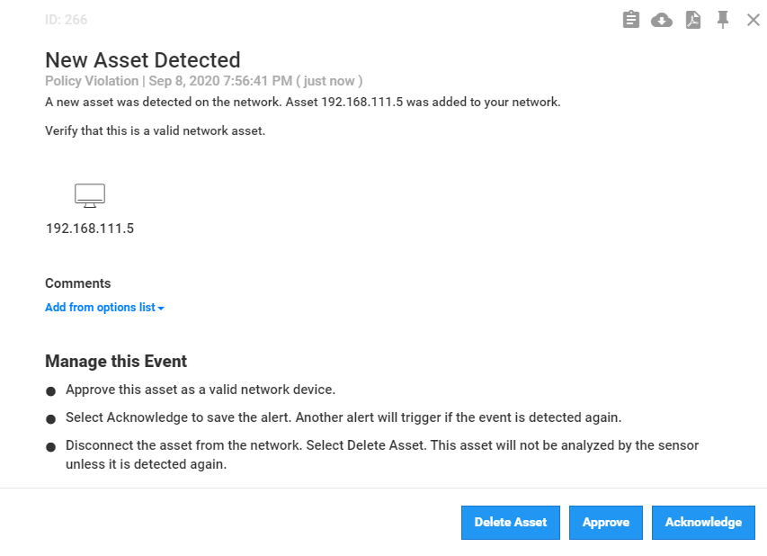
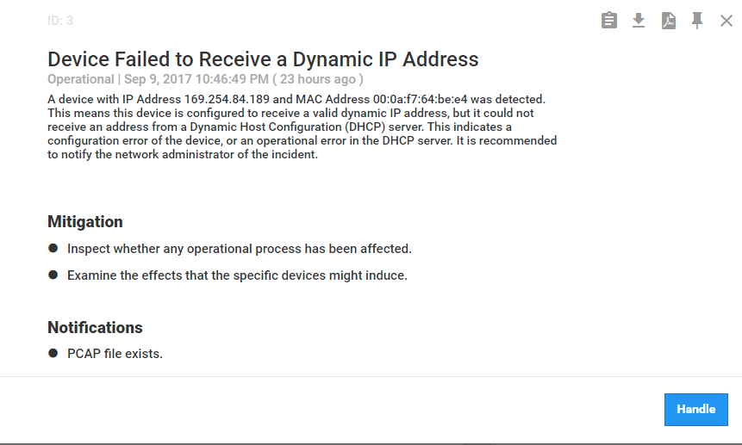
Malicious activity performed by a new discovered device
Unauthorized DHCP configuration in the SCADA network
Can be an indication of a new, unauthorized device, operating in the network. This either a legitimate new device recently deployed in the network that trying to get dynamic IP address, or an indication for an unauthorized, or even a malicious activity in the network
Unauthorized device in the SCADA network
This is the first time that the platform identified traffic from/to this device

Slide 40

Top Industrial and IoT Challenges for CISOs
IT & OT are converging to support the business
“Security by obscurity” & “air-gap” concepts not relevant anymore
Perimeter security insufficient to address modern threats (sophisticated malware, targeted attacks, malicious insiders)
IoT devices are dramatically increasing the attack surface for enterprises
Some IoT devices can not support agents
Lack of visibility by IT security team
Plants typically don’t know which devices they have — or how they’re connected
IoT devices are being deployed and connected to enterprise networks without and security controls
Industrial networks are complex, heterogeneous & insecure by design
Non-IT protocols & non-standard devices (PLCs, DCUs, etc.)
Legacy unpatched Windows systems
Legacy insecure protocols (weak authentication, serial wrapped in IP, etc.)
Lack of qualified ICS security personnel
Need to supplement in-house teams with external expertise

Slide 41
IoT & ICS Security Maturity Model
 | Level 1 | Level 2 | Level 3 | Level 4
Asset Management
Threat Detection
Enable IT & OT Integration

Slide 42
IoT & ICS Security Maturity Model
 | Level 1 | Level 2 | Level 3 | Level 4
Asset Mgt | Asset documentation Spreadsheet | Dynamic Asset documentation | Alerting when new assets appear and retire | Integration with Asset Inventory database (CMDB)
 | Static network map | Accurate spreadsheet with IPs | Accurate network map with all assets in network topology | Automated network topology with device communications & protocol visibility
Threat Detection | No Anomaly Detection (AD) | AD via manual log review & signature-based alerts (IDS) | AD via continuous monitoring with behavioral analytics using self-learning | AD via continuous monitoring with behavioral analytics using self-learning and remediation processes
 | No incident response | Manual incident response | Automated incident response & threat hunting. Reviewed occasionally | Automated incident response & threat hunting with supporting processes and dedicated personal
 | No risk & vulnerability assessment | Yearly risk & vulnerability assessment | Automated risk & vulnerability assessment | Automated risk & vulnerability assessment with prioritized remediation
Enablement of IT & OT Integration | No threat modeling | Manual threat modeling | Automated threat modeling | Automated threat modeling and proactive remediation efforts
 | No alignment between security & operational teams | Planning alignment between security & operational teams | Basic integration of SOC for OT environment | Integrated SOC for OT environment with process and procedures fully defined an operational while sharing VA information

Slide 43
Questions to Consider…
How do you intend to manage OT security?
How are you going to integrate with the SOC?
Who is responsible for the security of the entire environment?
What other products do you manage for the security of your specific environment (AntiVirus, White-listing, Firewalls, Switches, PLCs, HMI, EWS, etc…)?
Do you plan to implement Zero-Trust and network segmentation?
What are you doing for Threat Intelligence / Threat Hunting?
What are you concerns about compliance?
Any other information we should be aware of?
Notes:
Would like to hear more about your challenges and vision

Slide 44
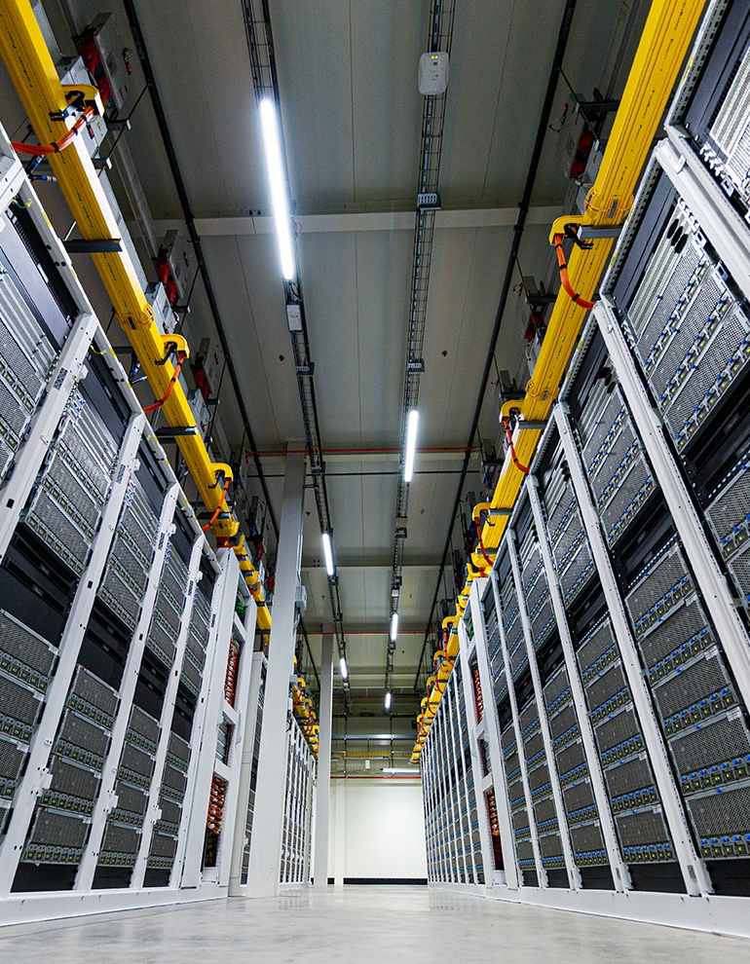
Learn more
Community:
IoT Security - Microsoft Tech Community
Watch the Microsoft Ignite session with demo:
http://aka.ms/ADforIoT-Ignite
Learn about product at:
http://aka.ms/ADforIoT-Product
http://aka.ms/ADforIoT-PP-Blog
Azure Sphere | Microsoft Azure
View on-demand webinars:
SANS: Bringing IT & OT Together — Expert Roundtable
SANS: A Principal Control Engineer’s Perspective on Defending Energy Utilities from IoT/ICS Attacks
Zero-Trust for IoT/OT Networks
Read our white papers, solution briefs & blog posts
MITRE ATT&CK for ICS
NIST Recommendations for IoT/ICS Security
TRITON Attack & OT Living-Off-The-Land Tactics
How IoT is Changing the CISO Role (Dark Reading)
Security Maturity Model
Notes:
We invite you to join our IoT security community and or access these resources to learn more

Slide 45
Questions?

